Slide 1

INT-375 Data Science Toolbox: Python Programming PROJECT REPORT (Project Semester January-April 2025)
(Exploratory Data Analysis On Diwali Sales Data )
Submitted by: Saurabh Kumar
Registration No: 12324770
Programme and Section: BTech CSE / K23WG
Course Code: INT-375

Slide 2
1)Introduction:
The Diwali Sales datasets captures consumer behavior during one of India’ most significant and high-activity commercial periods-the festival of Diwali. This Season is characterized by a cultural tradition of gift-giving and large-scale purchases, ranging from clothing and electronics to households’ items. For years, marketing analysts and data scientists have studied retail trends around Diwali to understand consumer psychology and spending habits. Researchers suggest that Diwali shopping patterns offer a unique lens into how festive sentiment drives economic activity across regions, age group and occupations.

Slide 3
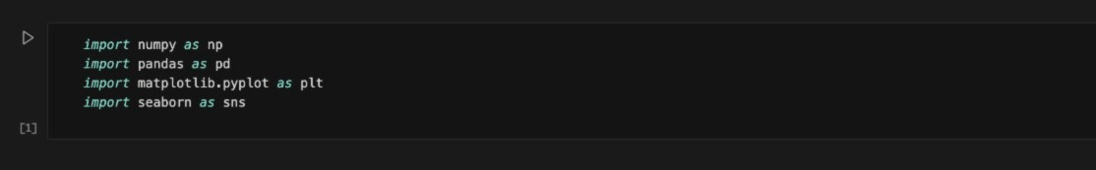
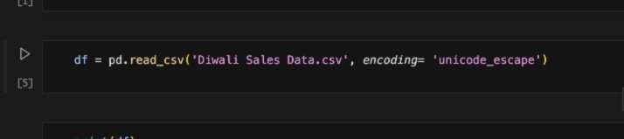
2)Dataset Preprocessing:
Loading and Listing Data:
At first, we need to load the data for preprocessing so importing necessary libraries is the first step and to do so enter the following code:
Fig 3.1.1 Importing Libraries
Now, after importing the necessary libraries we need to load the CSV (Comma Separated Value) file and to do that the following is the code.
Fig 3.1.2 Loading Dataset

Slide 4
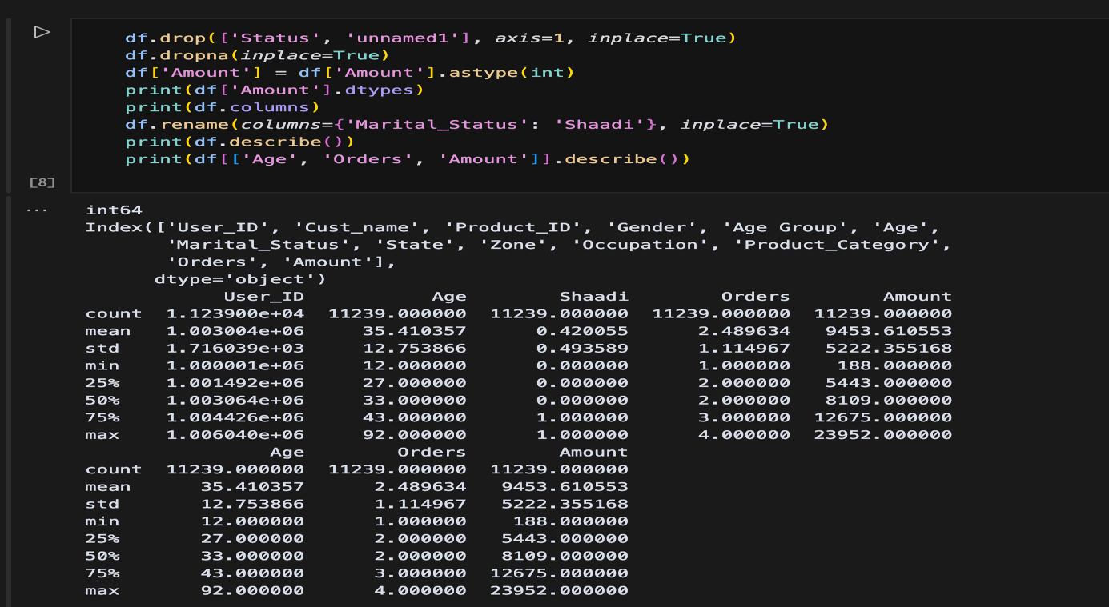
2.Redefine Columns: To enhance readability and structure it is prominent to rename the columns accordingly as it allows in more descriptive and efficient analysis. The following code is to redefine all the columns at once:

Slide 5
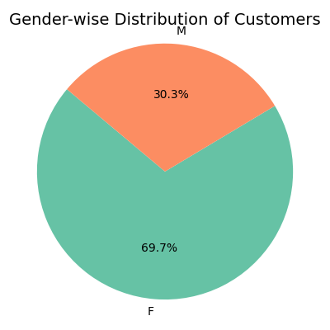
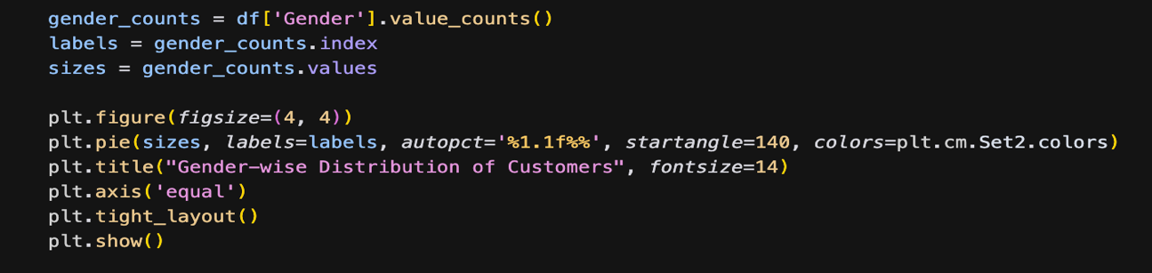
4).Analysis on Dataset
a).Objective-1: To analyze the distribution of Customer Gender wise(Pie Chart).
The column termed as “Gender” represents the biological gender of the customer making a purchase during the Diwali season. It is a categorical variable with two primary values: ‘M’(Male) and ‘F’(Female). This attribute is essential in understanding the consumer behavior differs across gender lines.

Slide 6
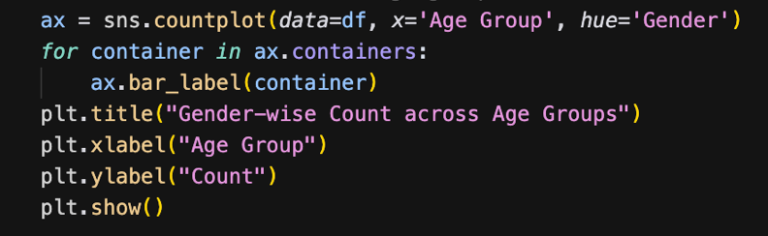
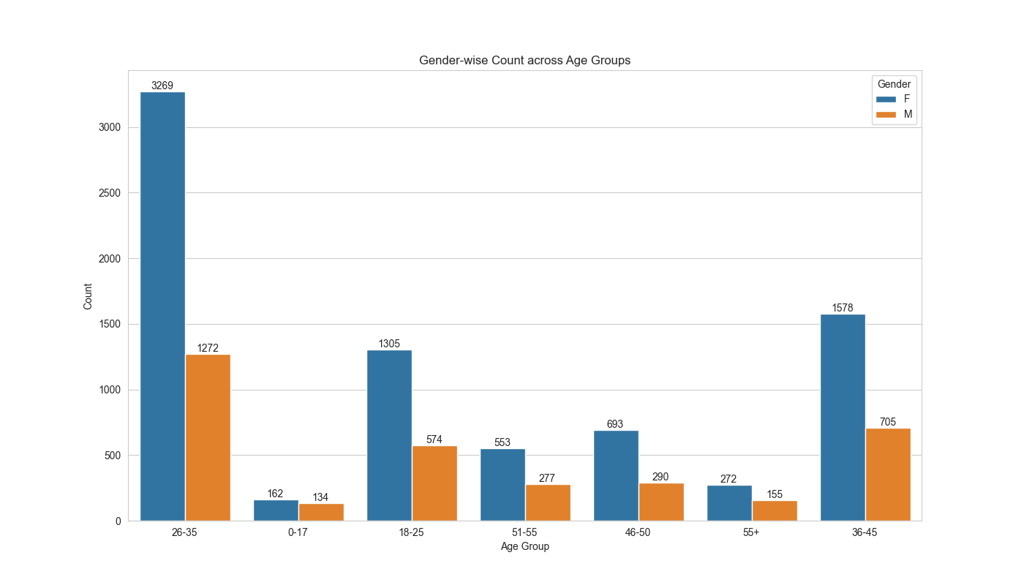
b).Objective-2: To Compare Gender wise count across age group(Column Chart): The “Age Group” and “Gender” columns in the dataset provide categorical data that help in identifying purchase behavior patterns across different demographics. By comparing the count of male and female customers across age groups, we can uncover which age group contributed the most during Diwali shopping, and whether there is a gender-based preference or dominance in any age bracket.

Slide 7
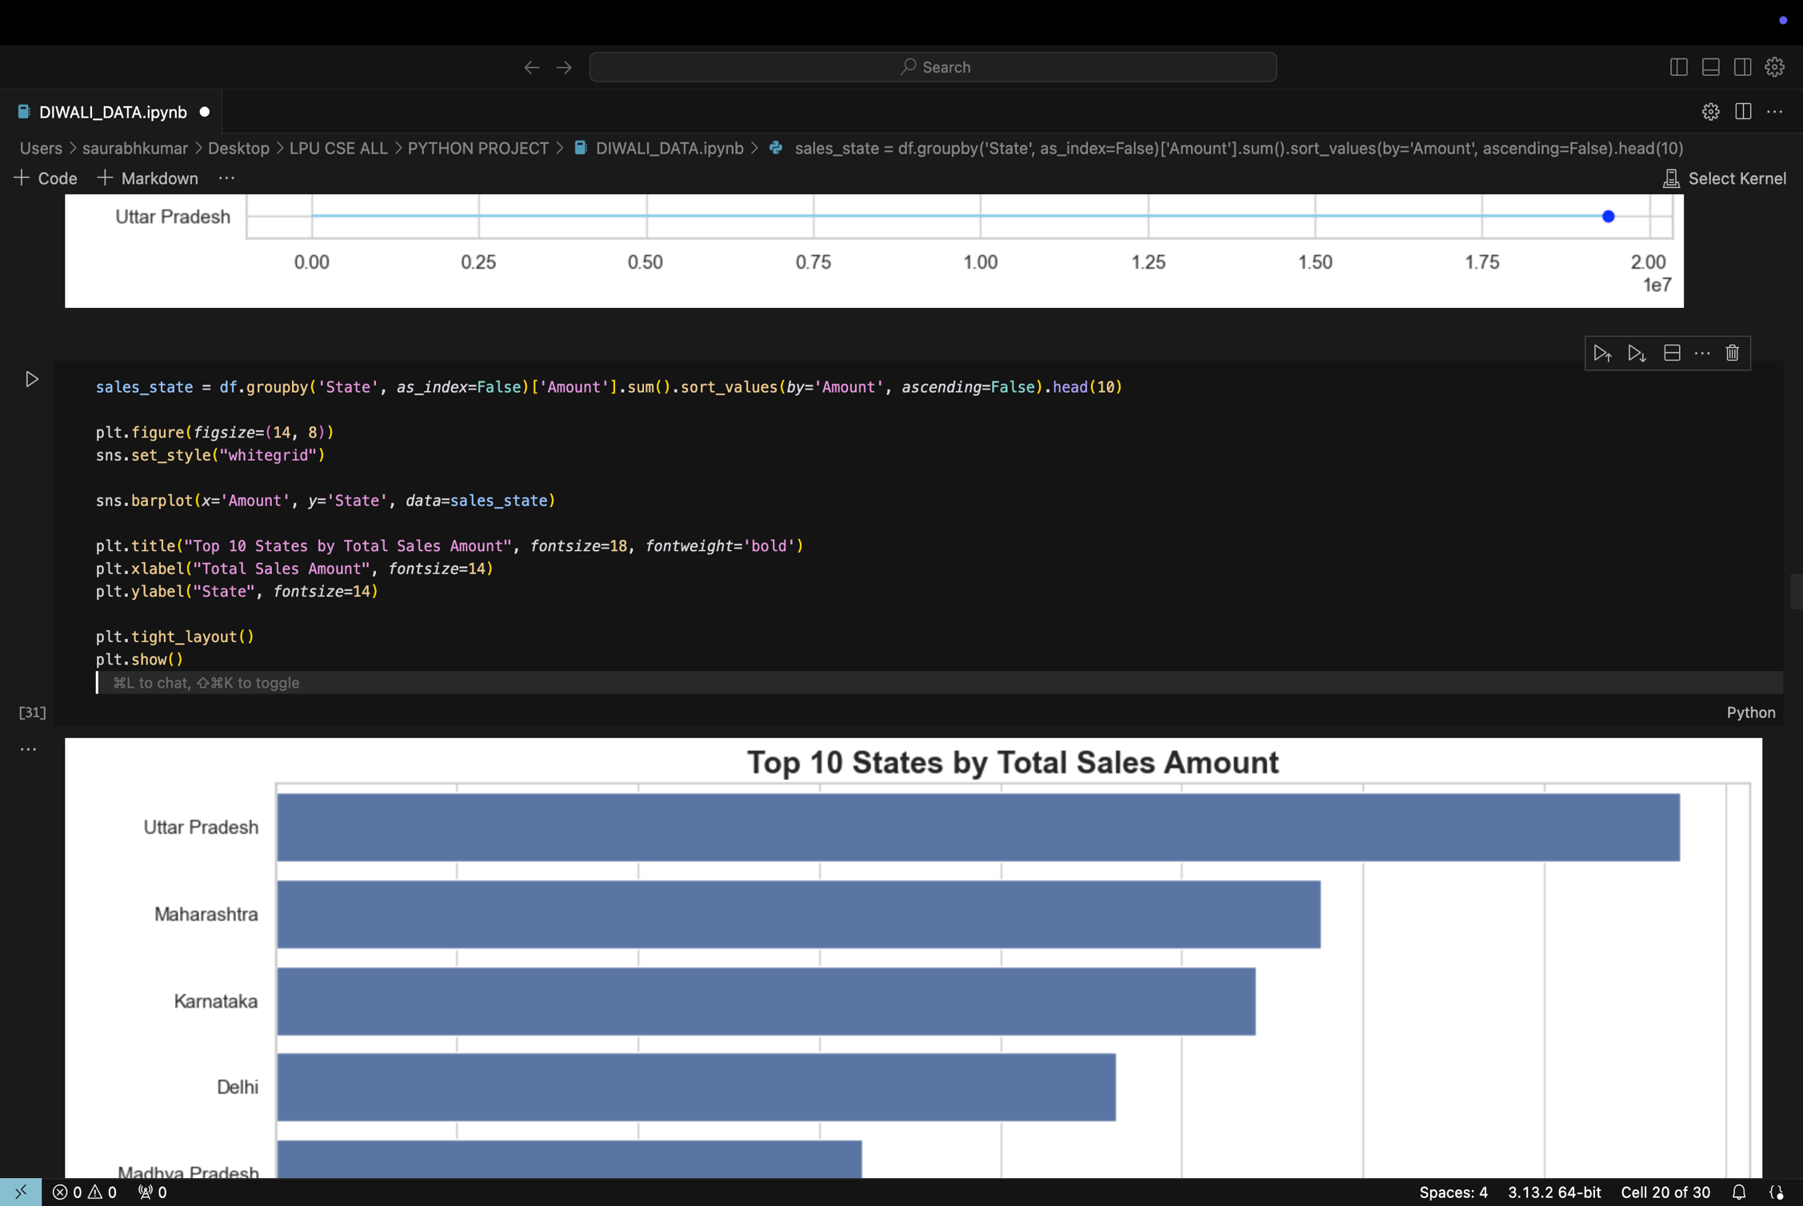
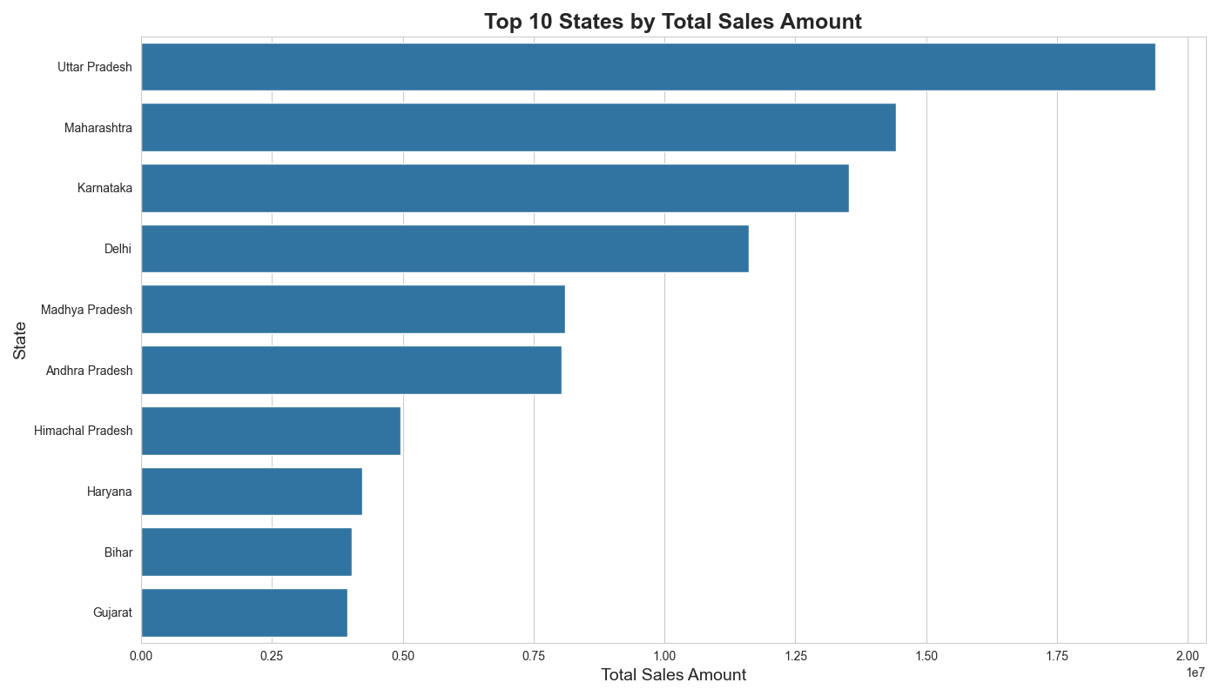
c).Objective-3: To Show top 10 state by total Sales amount(Row Chart). The “State” column in the dataset helps in identifying which Indian states contributed most to the total sales during the Diwali season. By aggregating the total sales (Amount) across different states, we can determine regional patterns of consumer behavior, helping retailers and marketers understand which geographical areas are most profitable. This analysis can be used to optimize supply chain planning, allocate promotional budgets wisely, and focus on states with higher consumer demand during festivals.

Slide 8
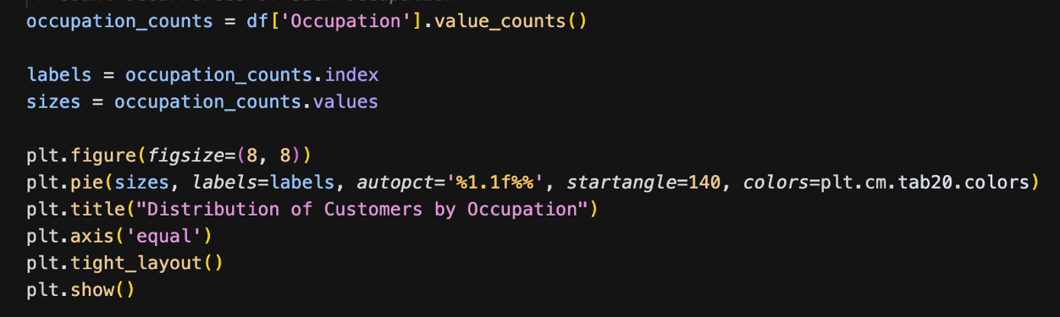
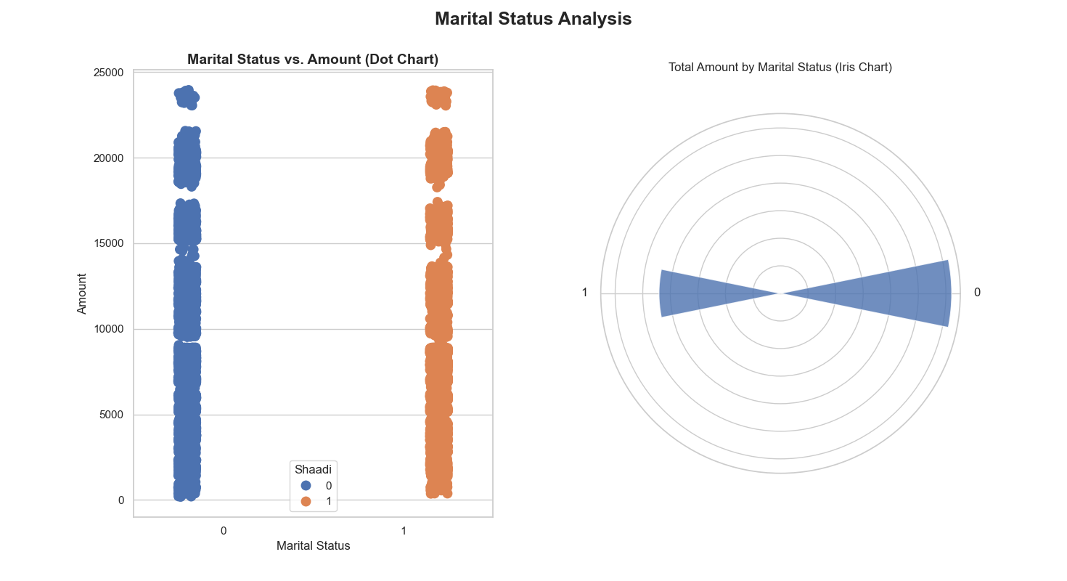
d).Objective-4: To Change for marital Status analysis: In the context of consumer analytics, marital status can often influence shopping behavior, especially during culturally significant periods like Diwali. The dataset contains a column labeled “Shaadi” (representing Marital Status), where customers are categorized as either Married or Unmarried.

Slide 9
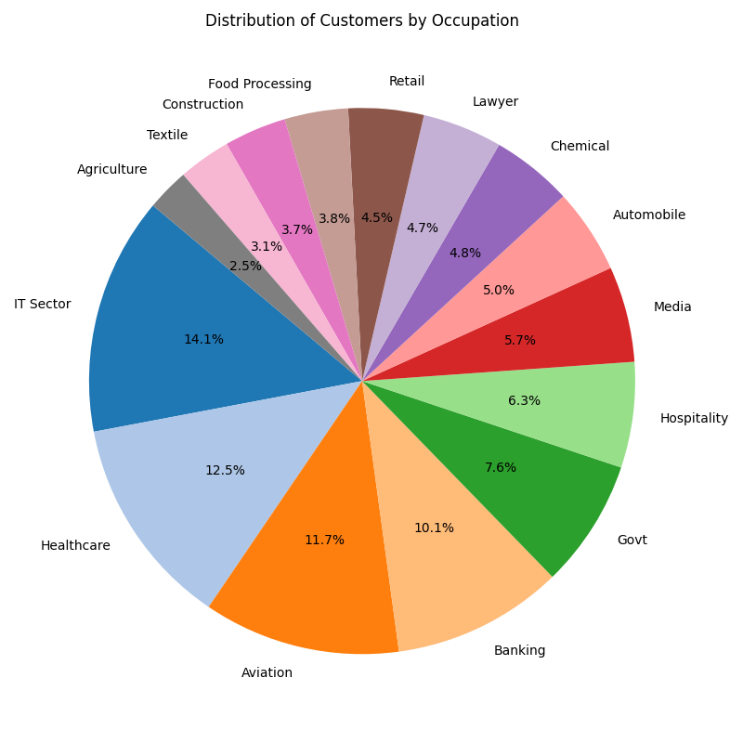
e).Objective-5:To Visualize distribution of customer by occupation: The “Occupation” column in the dataset represents the professional background of the customers, such as IT Sector, Healthcare, Government, and other industry types. Understanding the distribution of customers by occupation helps in identifying which professional groups are more active participants in festive season purchases. This analysis provides useful insight into consumer behavior across different economic segments and helps in tailoring marketing strategies to suit the buying patterns of specific occupational groups.

Slide 10

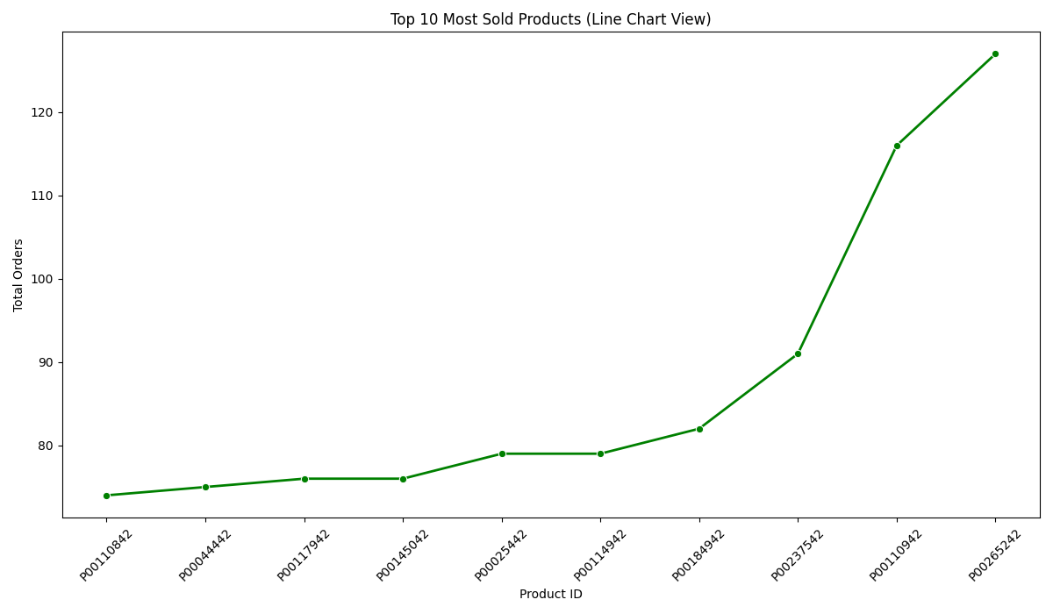
4.6: Top 10 M4.6: Top 10 Most Sold Products. (Line Chart)
Identify the specific products that are driving the highest sales volume. Show the relative performance of the top 10 products in terms of order quantity. Potentially reveal trends in product popularity

Slide 11
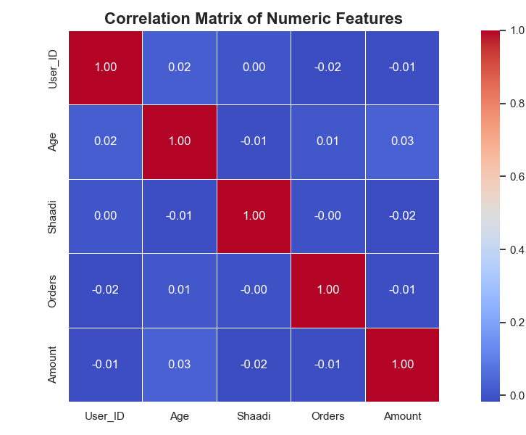
4.7: Correlation Matrix of numeric features.(Heat Map)
In this context, the specific objective is to understand the linear relationships between numerical features like User ID, Age, Shaadi (Marital Status), Orders, and Amount in the Diwali sales data. This helps in identifying if and how these features are related to each other, which can provide insights into customer behavior and sales patterns.
Sources and related content

Slide 12
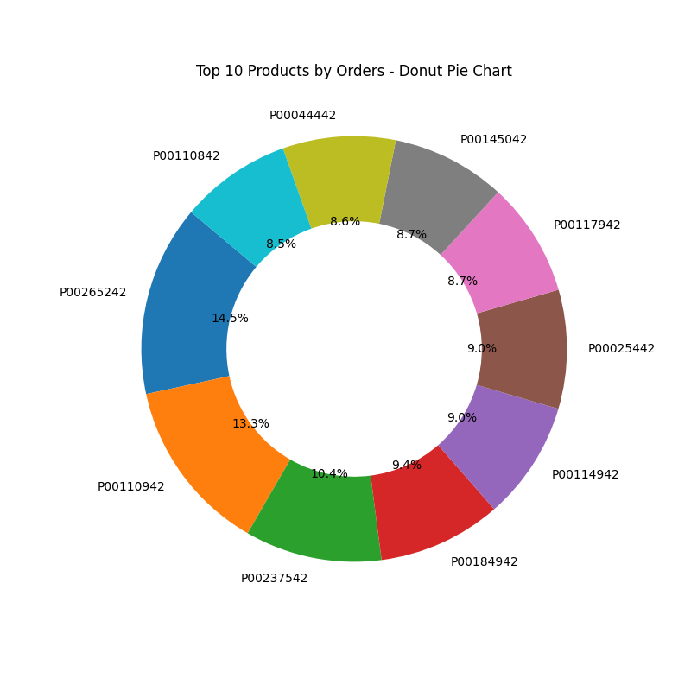
4.8: Top 10 Products by Orders.(Donut Chart)
this chart is to visualize the distribution of orders across the top 10 most ordered products. It highlights the relative proportion of orders for each of these products, allowing for a quick comparison of their popularity based on order volume. The chart helps to identify which products are the most significant contributors to the total order count.

Slide 13
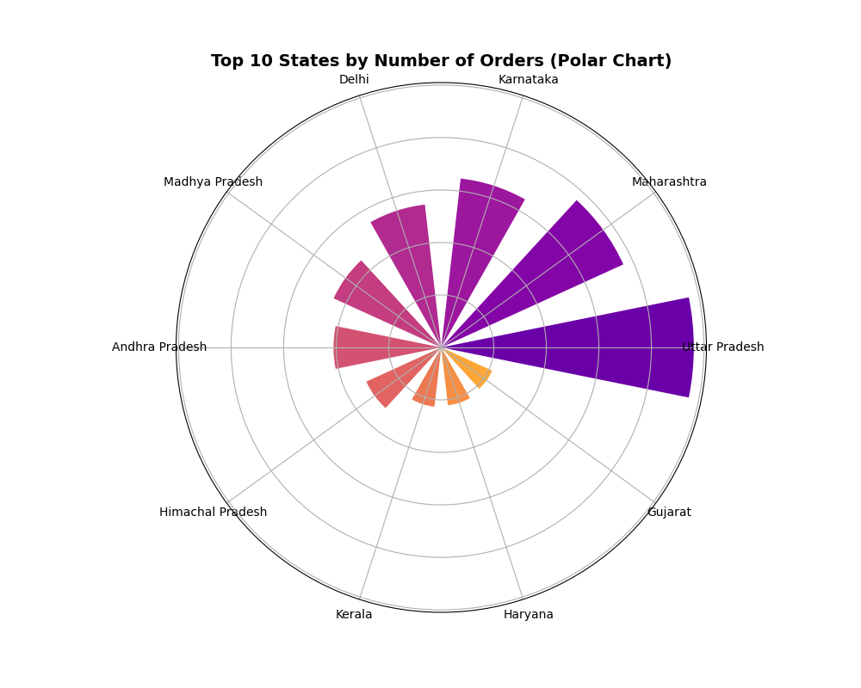
4.9: Top 10 states by number of orders.(Polar Chart)
this polar chart is to visually compare the number of orders originating from the top 10 states during the Diwali sales period. It allows for a quick and intuitive understanding of which states contribute the most and least to the total order volume among the top states.

Slide 14
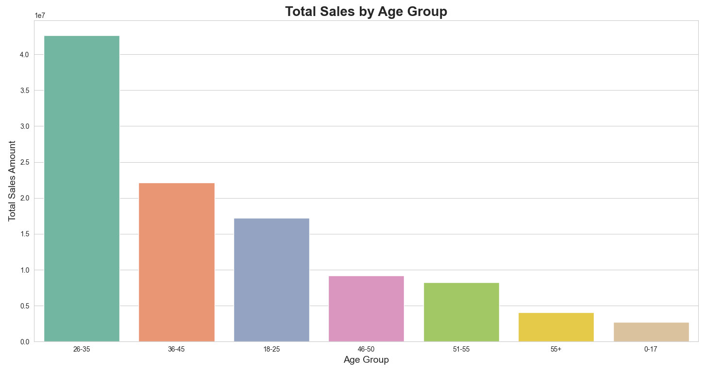
4.10: Total Sales by Age Group. (Column Chart)
this chart is to visualize the total sales amount across different age groups. It allows for a comparison of the spending behavior of various age demographics during the Diwali sales period. The height of each bar represents the total sales amount for that particular age group. This visualization helps to identify which age groups contribute the most and least to the overall sales revenue.

Slide 15
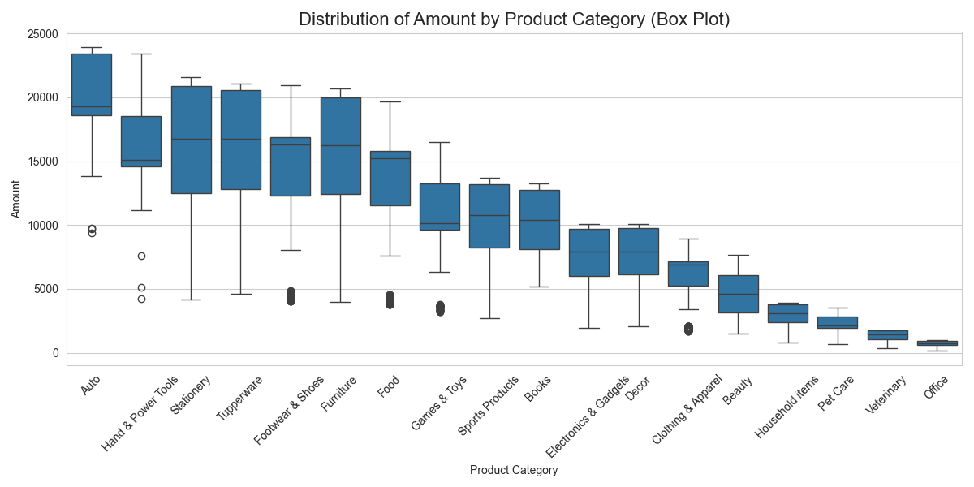
4.11: Distribution of Amount by Product Category. (Box Plot)
this box plot is to visualize and compare the distribution of purchase amounts across different product categories during the Diwali sales . information can be valuable for business decisions related to inventory, marketing, and pricing strategies for different product categories during the Diwali season.

Slide 16
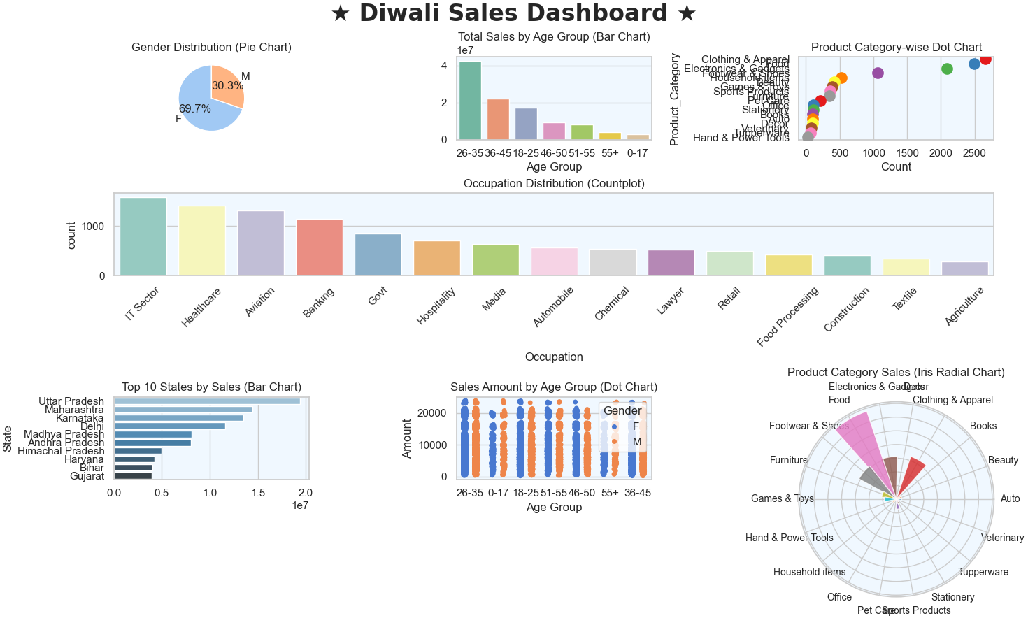
4.12: Diwali Sales Dashboard. (Mix Graph)

Slide 17

5)Conclusion:
The Diwali Sales Dashboard offers a comprehensive and visually appealing analysis of various factors influencing sales during the Diwali season, combining a diverse set of charts and graphs to present data from multiple perspectives. The analysis uses a real-world dataset, which includes demographic details, sales amounts, and product categories, to identify key trends and insights from the Diwali sales campaign.
The overall dashboard provides a holistic view of Diwali sales, combining both demographic and product-level insights. The seamless integration of various visualization types—pie, bar, dot, count, and radial charts—ensures that the user can easily interpret different aspects of the data, from customer demographics to sales distribution across geographical regions and product categories.

Slide 18
6).Future Scope
6.1 Predictive & Adaptive Modelling:
Relation to Image: If the image plots meteorite fall locations (latitude, longitude), this visual dataset can serve as a strong foundation for training machine learning models such as regression, decision trees, or neural networks.
Practical Tip: Label this map data and prepare it into feature sets (e.g., location, mass, year) to begin building your ML pipeline.
6.2 Time Series Analysis:
Relation to Image: If the image includes timestamps or temporal patterns (e.g., by color or marker type), this can be used to apply ARIMA, LSTM, or Prophet models for forecasting.
Next Step: Group data by year or month, plot trends, and feed it into time-aware models to see seasonal or periodic meteorite behavior.
6.3 Clustering Methodology:
Relation to Image: The distribution and density of points may reveal natural clusters—K-Means or DBSCAN can help formalize these clusters.
Insight: You might discover that certain meteorite types or masses are region-specific or era-specific—use this to guide further scientific queries.
6.4 Impact Analysis of Outliers:
Relation to Image: If some markers are significantly larger or darker, they could represent higher mass meteorites—key outliers for impact study.
What to Do: Analyze these data points separately. Cross-reference with known meteorite events that caused atmospheric or geological changes.
6.5 Real-Time Data Integration:
Relation to Image: While this static image represents historical data, layering real-time feeds over a similar visualization would create a dynamic tool.
How to Build: Use satellite feeds, telescopic input, or APIs (e.g., NASA's Near Earth Object Web Service) and pipe data into a visual dashboard.

